Slide 1

Information and Network Security(INS)

Slide 2
INS - Lecture 10 Presented by: Drashti Shrimal

Slide 3
UNIT 1: Topics in this presentation
Substitution Techniques (Part 1):
- Monoalphabetic Cipher
- Caesar Cipher

Slide 4
Substitution Techniques in Encryption
1. Monoalphabetic Cipher
a.k.a Simple Substitution cipher.
i.e Substitution is fixed for each letter of the alphabet.
So if “A” is replaced by “R”, then everytime in that plaintext “A will be replaced by “R”.

Slide 5
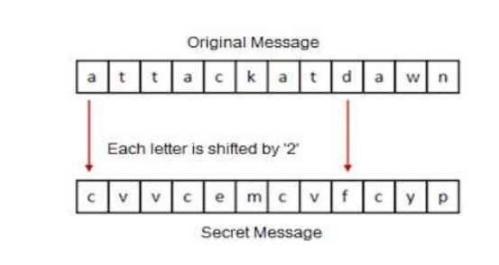
Monoalphabetic Cipher Example
Suppose we decide Key = +2

Slide 6
Substitution Techniques in Encryption
2. Caesar Cipher:
- Created by Julius Caesar.
- The Caesar cipher involves replacing each letter of the alphabet with the letter standing 3 places further down the alphabet.

Slide 7
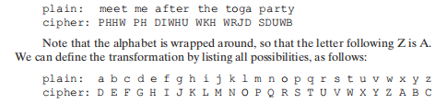
Caesar Cipher Example

Slide 8
Disadvantages of Caesar Cipher
Simple structure usage.
Can only provide minimum security to the information.
Frequency of the letter pattern provides a big clue in deciphering the entire message.

Slide 9
Thanks!
Any questions?
You can post your questions on Google Classroom.

